Slide 1
— Lectorial 10 Naïve Bayes
Machine Learning @ RMIT

Slide 2
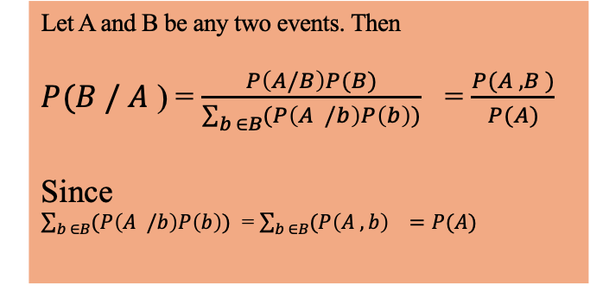
Review of Bayes’ Rule
Let A and B be any two events. Then
$P(B / A$ ) = $\frac{P\left(A/B\right)P(B)}{\sum_{b ∈B}{(P\left(A /b\right)P\left(b\right))}}$ = $\frac{P(A , B )}{P(A)}$
Since
$\sum_{b ∈B}{(P\left(A /b\right)P\left(b\right))}$ = $\sum_{b ∈B}{(P\left(A ,b\right) =P(A)}$
So, Bayes’ rule essentially is used to reverse a conditional probability.

Slide 3
Example: Heart failure and coughing.
It is known that coughing can be associated with heart failure.
However, does it mean that if you have a cough, you automatically will have heart failure?
No, we intuitively know that this is not true.
How do we know this intuitively?
Conditional probabilities:
We know that
P(cough | hear failure) and
P(heart failure | cough) are not the same.

Slide 4
Let’s use some numbers and calculate
P(heart failure | cough )
Assume some made up statistics:
P(cough = T | Heart Failure = T ) = 99%
P(cough = F | Heart Failure = T) = 1%
P(cough = T | Heart Failure = F ) = 1%
P(cough = F | Heart Failure = F ) = 99%
Let us also assume that
P( Heart Failure = T ) = 0.02% , P(Heart Failure = F) = 99.98%

Slide 5
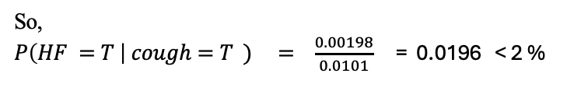

$$P\left(HF =T \right| cough=T ) = \frac{P\left(cough=T \right|HF=T) P(HF=T)}{P(cough=T)}$$
Numerator = 99% * 0.02% = 0. 000198
Now the denominator gives us :
P(cough = T ) = P(cough = T | HF = T) * P(HF = T) + P(cough = T | HF = F) * P(HF = F)
= 99% * 0.02% + 1% * 99.98% = 0.0101
So,
$P\left(HF =T \right| cough=T ) = \frac{0.00198}{0.0101}$ = 0.0196 < 2 %

Slide 6
Lesson:
Bayes’ Rule tells us that if one has a symptom of a very rare disease, one does not necessarily have to be worried
about having the disease.
That is
P(A | B ) can be very different from P(B | A).

Slide 7
Naïve Bayes’ Intuition:
Naïve Bayes’ is a classification algorithm
Email
spam
not spam

Slide 8
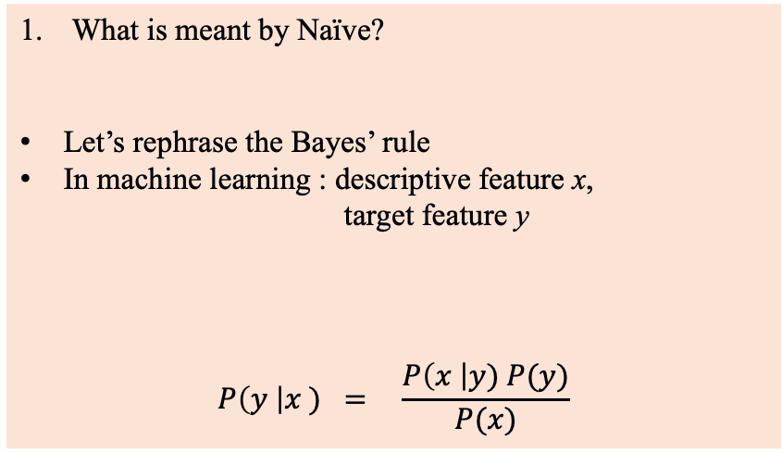
What makes the Naive Bayes’ classifier Naïve?
What kinds of Naïve Bayes’ classifiers are included in sci-kit learn?
What is meant by Naïve?
Let’s rephrase the Bayes’ rule
In machine learning : descriptive feature x,
target feature y
$$P\left(y \right|x ) = \frac{P\left(x \right|y) P(y)}{P(x)}$$
Example :
x = cough
y = covid or no covid

Slide 9
Let’s make it more realistic:
Target = y = covid /no covid
x₁ = cough
x₂ = sore throat
x₃ = fever
x₄ = aches and pains
………
So, input = X = (x₁, x₂, x_{3,} x₄).
x₁ | x₂ |  |  |  |  | x_{D}

Slide 10
What is meant by Naïve:
What it means is that we assume “independence “ of the feature variables x₁, x₂, ….., x_{D}
i.e. cough is independent of fever, is independent of sore throat etc.
Naïve Assumption: All of these D inputs are independent of each other
Is this realistic?
of course NOT!!!
But we can get away with this assumption
In ML we don’t need a model to perfectly resemble reality
We only need a model that works and gives us good predictions

Slide 11
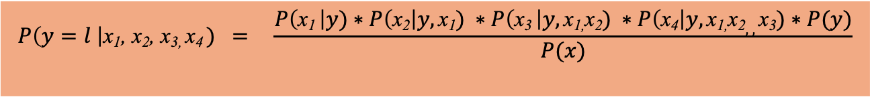
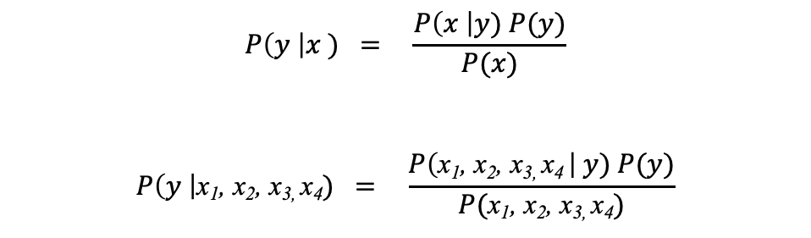

$$P\left(y \right|x ) = \frac{P\left(x \right|y) P(y)}{P(x)}$$
$$P\left(y \right|\text{x}\text{1}\text{, }\text{x}\text{2}\text{, }\text{x}\text{3, }\text{x}\text{4}) = \frac{P\left(\text{x}\text{1}\text{, }\text{x}\text{2}\text{, }\text{x}\text{3, }\text{x}\text{4} \right| y) P(y)}{P(\text{x}\text{1}\text{, }\text{x}\text{2}\text{, }\text{x}\text{3, }\text{x}\text{4})}$$
$$P\left(y=l \right|\text{x}\text{1}\text{,} \text{x}\text{2}\text{, }\text{x}\text{3, }\text{x}\text{4} ) = \frac{P\left(\text{x}\text{1} \right|y)∗P\left(\text{x}\text{2}\right|y,\text{x}\text{1}) ∗P\left(\text{x}\text{3} \right|y,\text{x}\text{1}\text{,}\text{x}\text{2}) ∗P\left(\text{x}\text{4}\right|y,\text{x}\text{1}\text{,}\text{x}\text{2},,\text{x}\text{3})∗P(y)}{P(x)}$$
For each l $ε \left(target level\right)$
And for each value combination $\text{x}\text{1}\text{, }\text{x}\text{2}\text{, }\text{x}\text{3, }\text{x}\text{4}$ can take.

Slide 12

$P\left(y=l \right|\text{x}\text{1}\text{,} \text{x}\text{2}\text{, }\text{x}\text{3, }\text{x}\text{4} ) =P\left(\text{x}\text{1} \right|y)∗P\left(\text{x}\text{2}\right|y,\text{x}\text{1}) ∗P\left(\text{x}\text{3} \right|y,\text{x}\text{1}\text{,}\text{x}\text{2}) ∗P\left(\text{x}\text{4}\right|y,\text{x}\text{1}\text{,}\text{x}\text{2},,\text{x}\text{3})∗P(y=l$)

Slide 13

Probability Distributions for Naïve Bayes’ Rule:
$$P\left(y \right|x ) = \frac{P\left(x \right|y) P(y)}{P(x)}$$

Slide 14
Bernoulli Distribution:
In the previous example where a
X = patient could have a cough (1) or no cough (0)
the descriptive feature X there is a binary variable.
So, for the different levels of the target variable, we can plot the distribution of X as follows:

Slide 15
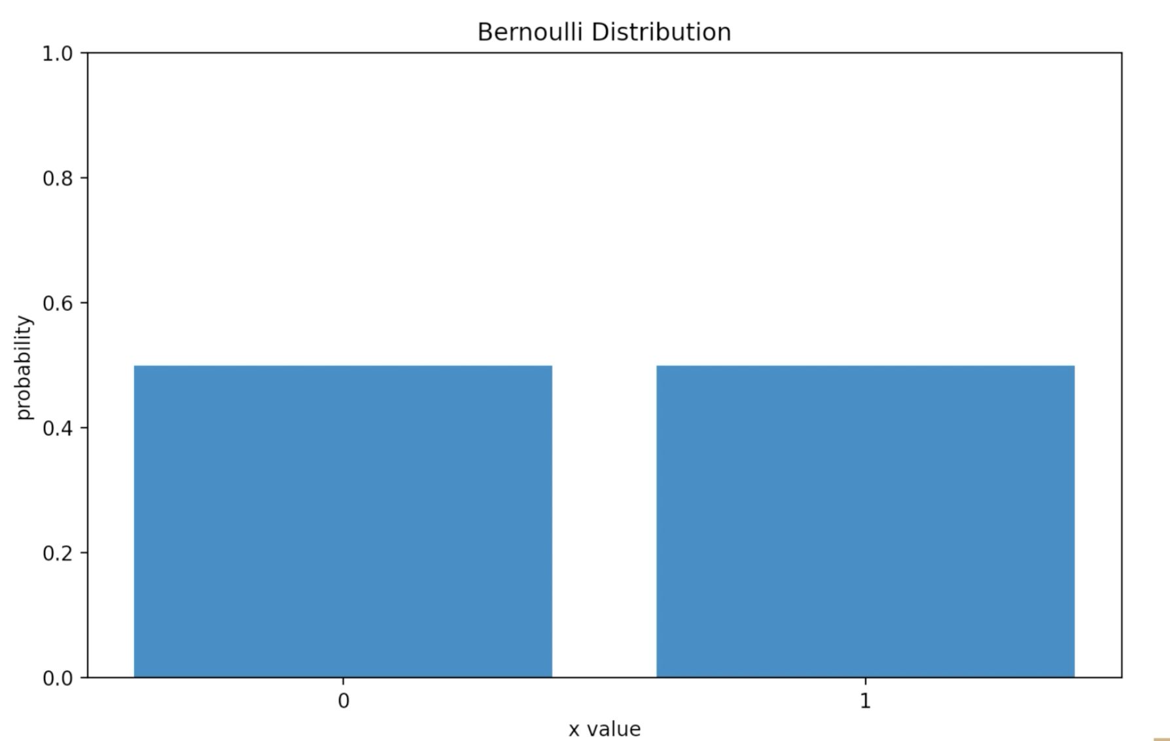

Slide 16
Next if we compare the distribution of X = patient has cough (1) or no cough(0)
Target = y = covid (1), no covid (0)

Slide 17
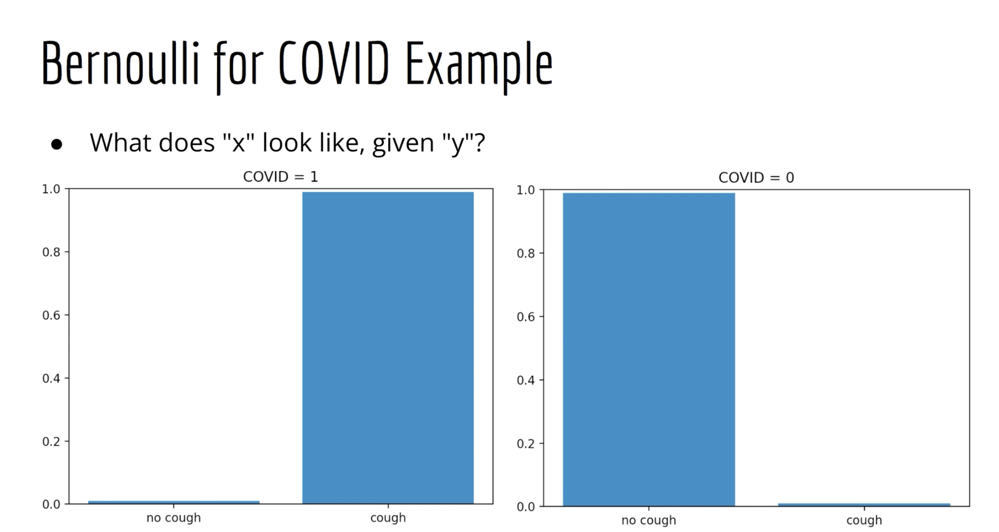

Slide 18
Gaussian Distribution
The Gaussian distribution can be used when one (or more ) of your descriptive features
is continuous numerical.
Read the example given in Table 6:11 of chapter 6 of the textbook on Probability – Based
Learning.

Slide 19
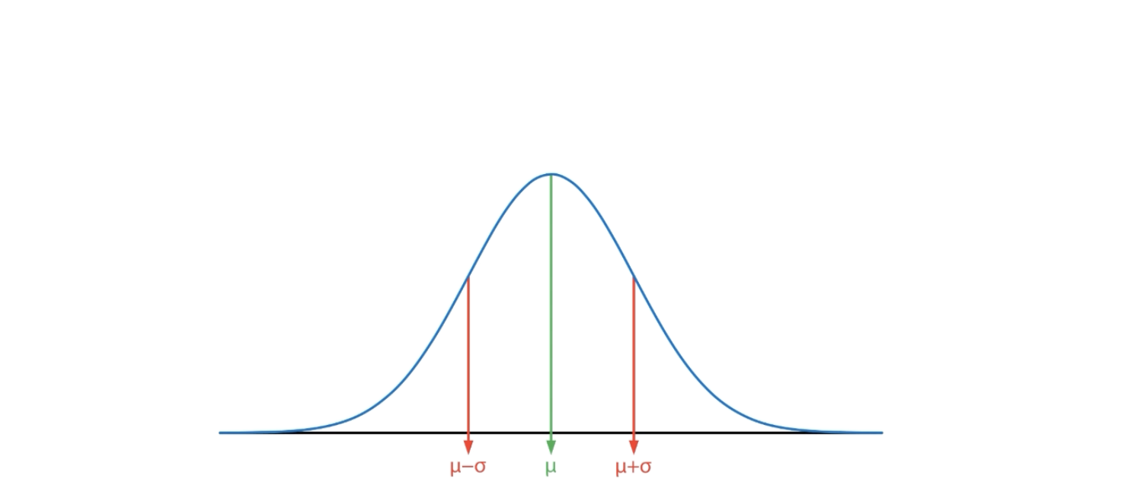

Slide 20
In most data sets that we have to analyze feature variables
are continuous, numerical.
Examples: Financial data (share prices, currency exchange rates)
healthcare and medical diagnostic data such as blood pressure readings,
BMI readings, glucose concentration etc.

Slide 21
Summary:
Naïve Bayes’ is a classification algorithm
Visualize the data formats
Bayes’ Rule
Naïve Bayes’ Classifier
What does P(x | y) looks like
How to compute P(y | x)

